Slide 1
Analog and Digital Electronics
By. V.C. Togadiya

Slide 2
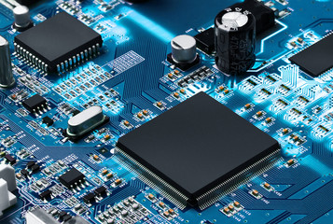
Chapter-1 Junction –Diode & Transistor Characteristics
Introduction about Electronics
The field of electronics is a branch of Physics and electrical engineering that deals with the emission, behavior and effects of electrons using electronics devices.
Electronics uses active devices to control electron flow by amplification and rectification, which distinguishes it from classical electrical engineering, which only uses passive effects such as resistance, capacitance and inductance to control electric current flow.

Slide 3
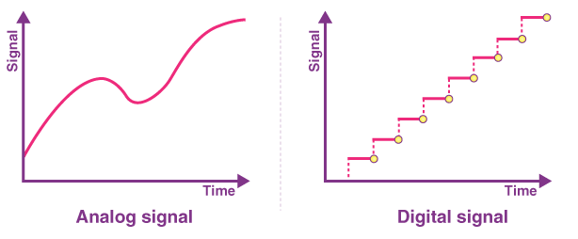
Difference Between Analog and digital electronics
Analog and digital signals are the types of signals carrying information. The major difference between both signals is that the analog signals have continuous electrical signals, while digital signals have non-continuous electrical signals.

Slide 4
Continue..
Analog | Digital
Continuous signals | Discrete signals
Represented by sine waves | Represented by square waves
Human voice, natural sound, analog electronic devices are a few examples | Computers, optical drives, and other electronic devices
Continuous range of values | Discontinuous values
Records sound waves as they are | Converts into a binary waveform
Only used in analog devices | Suited for digital electronics like computers, mobiles and more

Slide 5
About Semiconductor
A semiconductor is a substance whose resistivity lies between the conductors and insulators. The property of resistivity is not the only one that decides a material as a semiconductor, but it has few properties as follows.
Semiconductors have the resistivity which is less than insulators and more than conductors.
Semiconductors have negative temperature co-efficient. The resistance in semiconductors, increases with the decrease in temperature and vice versa.
The Conducting properties of a Semiconductor changes, when a suitable metallic impurity is added to it, which is a very important property.

Slide 6
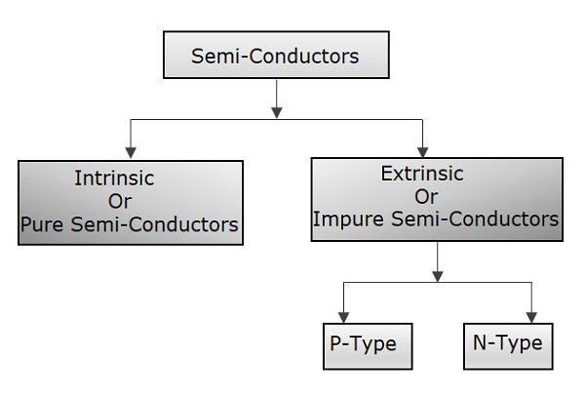
Continue..
Semiconductor devices are extensively used in the field of electronics. The transistor has replaced the bulky vacuum tubes, from which the size and cost of the devices got decreased and this revolution has kept on increasing its pace leading to the new inventions like integrated electronics.

Slide 7
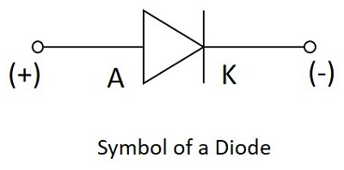
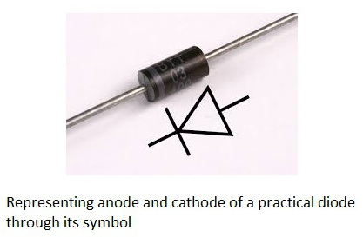
PN Junction diode
A semiconductor diode is a two terminal electronic component with a PN junction.
The anode which is the positive terminal of a diode is represented with A and the cathode, which is the negative terminal is represented with K. To know the anode and cathode of a practical diode, a fine line is drawn on the diode which means cathode, while the other end represents anode.

Slide 8
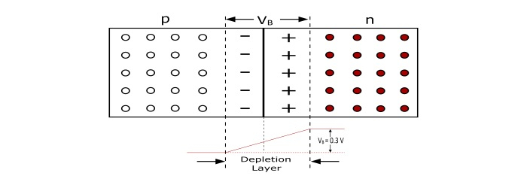
Continue..
Construction
Barrier is set up against the movement of charge carriers across the junction. This is called Potential Barrier (V_{B}). The value of V_{B} ranges from 0.1 to 0.7 V.

Slide 9
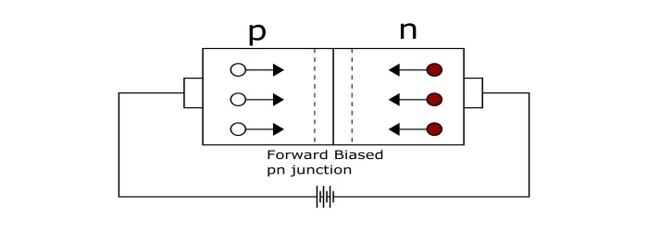

Biasing of PN Junction and I-V Forward biasing characteristics
The biasing conditions for a pn–junction are of two types −
Forward Biasing
Reverse Biasing
During the operation, when the diode is in forward biased condition, at some particular voltage, the potential barrier gets eliminated. Such a voltage is called as Cut-off Voltage or Knee Voltage.

Slide 10
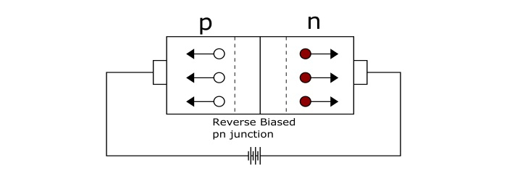
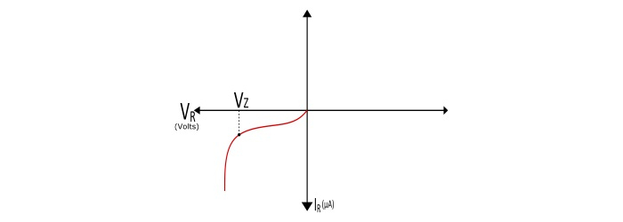
Reverse Biasing Characteristics
.
To make the pn–junction reverse biased, connect the negative terminal of battery to the p–type material and positive terminal to the n–type material. The electric field due to the applied reverse voltage acts in the same direction as the field due to potential barrier. The increased potential barrier prevents the flow of charge carriers across the junction. Hence, the junction offers very high resistance to the current flow

Slide 11
Continue..
From I–V characteristics of reverse biased junction, it can be seen that a small current of the order of a few μA flows in the circuit under reverse bias.
As the applied voltage is increased in the reverse direction a point is reached where breakdown of the pn–junction takes place and a high amount of current starts flowing through the pn-junction and the voltage corresponding to this point is called as breakdown voltage or Zener Voltage (V_{Z}). The sudden rise of reverse current may damage the junction permanently due to excessive heat.

Slide 12
Rectifier
It is a circuit which convert AC voltage into DC voltage the circuit is known as a rectifier circuit and the process is known as rectification.
Types of Rectifier circuits
There are two main types of rectifier circuits, depending upon their output. They are
Half-wave Rectifier
Full-wave Rectifier

Slide 13
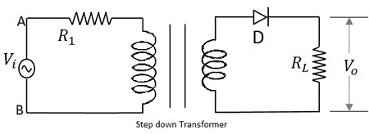
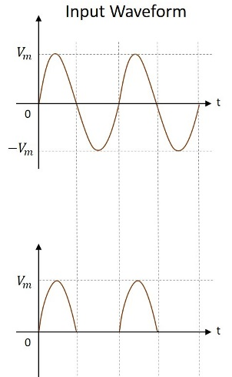
Half-Wave Rectifier

Slide 14
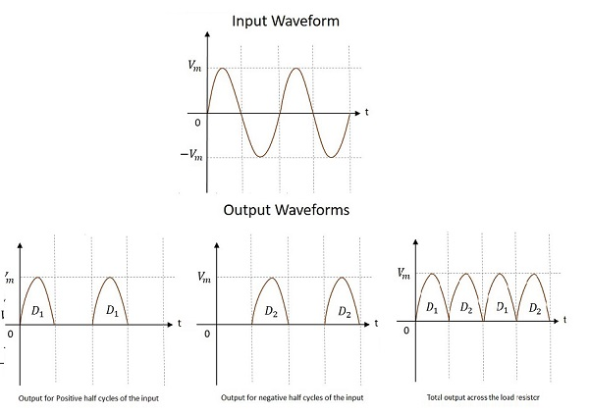
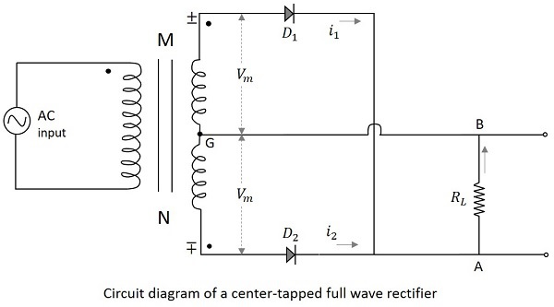
Center-tapped Full-Wave Rectifier

Slide 15
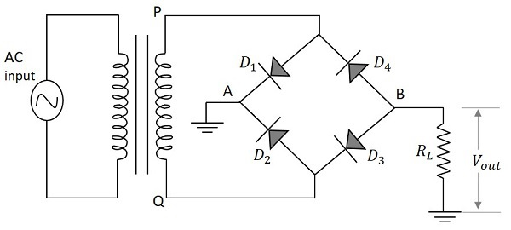
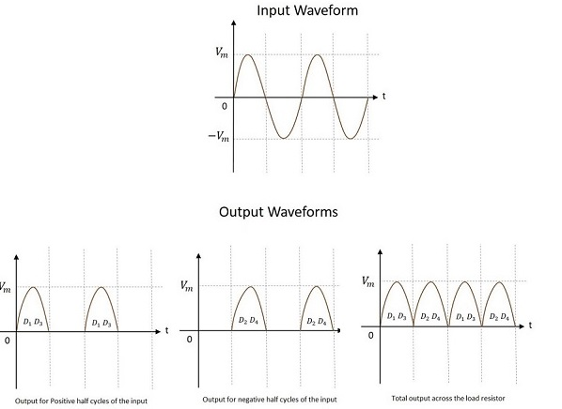
Bridge Full-Wave Rectifier

Slide 16
Comparision
Terms | Half Wave Rectifier | Center Tapped FWR | Bridge FWR
Number of Diodes | 1 | 2 | 4
Transformer tapping | No | Yes | No
Peak Inverse Voltage | Vm | 2Vm | Vm
Maximum Efficiency | 40.6% | 81.2% | 81.2%

Slide 17
Transistor
After having a good knowledge on the working of the diode, which is a single PN junction, let us try to connect two PN junctions which make a new component called Transistor. A Transistor is a three terminal semiconductor device that regulates current or voltage flow and acts as a switch or gate for signals.
Why Do We Need Transistors?
Suppose that you have a FM receiver which grabs the signal you want. The received signal will obviously be weak due to the disturbances it would face during its journey. Now if this signal is read as it is, you cannot get a fair output. Hence we need to amplify the signal. Amplification means increasing the signal strength.

Slide 18
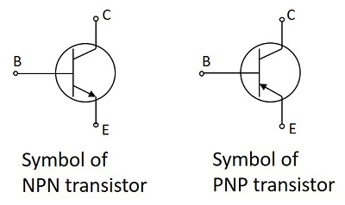
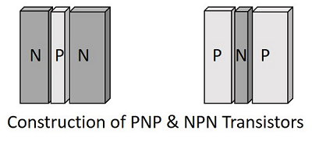
Constructional Details of a Transistor

Slide 19
Continue..
Emitter
The left hand side of the above shown structure can be understood as Emitter.
This has a moderate size and is heavily doped as its main function is to supply a number of majority carriers, i.e. either electrons or holes.
As this emits electrons, it is called as an Emitter.
This is simply indicated with the letter E.
Base
The middle material in the above figure is the Base.
This is thin and lightly doped.
Its main function is to pass the majority carriers from the emitter to the collector.
This is indicated by the letter B.
Collector
The right side material in the above figure can be understood as a Collector.
Its name implies its function of collecting the carriers.
This is a bit larger in size than emitter and base. It is moderately doped.
This is indicated by the letter C.

Slide 20
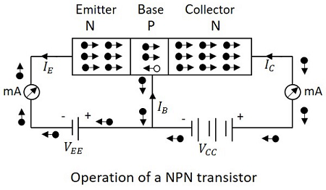
Operation NPN Transistor
The operation of an NPN transistor can be explained by having a look at the following figure, in which emitter-base junction is forward biased and collector-base junction is reverse biased.

Slide 21
Continue..
The voltage V_{EE} provides a negative potential at the emitter which repels the electrons in the N-type material and these electrons cross the emitter-base junction, to reach the base region. There a very low percent of electrons recombine with free holes of P-region. This provides very low current which constitutes the base current I_{B}. The remaining holes cross the collector-base junction, to constitute the collector current I_{C}.

Slide 22
Transistor Configuration
The three types of configurations are
Common Base,
Common Emitter
Common Collector

Slide 23
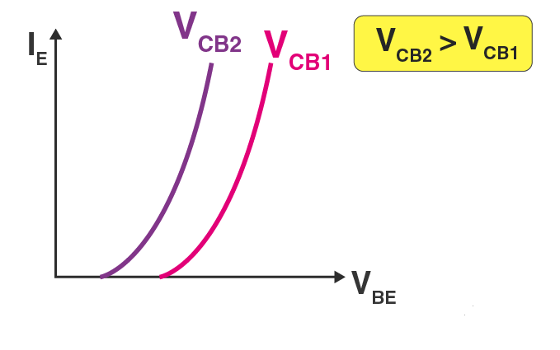
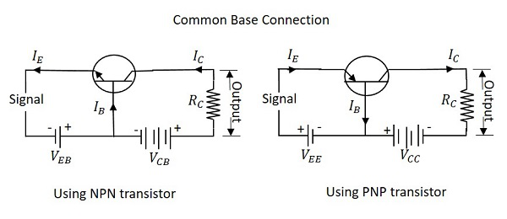
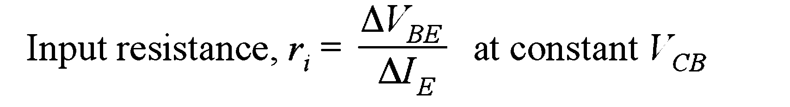
Common Base configuraton
The name itself implies that the Base terminal is taken as common terminal for both input and output of the transistor. The common base connection for both NPN and PNP transistors is as shown in the following figure.
The variation of emitter current(I_{E}) with Base-Emitter voltage(V_{BE}), keeping Collector Base voltage(V_{CB}) constant.
Input Characteristics

Slide 24
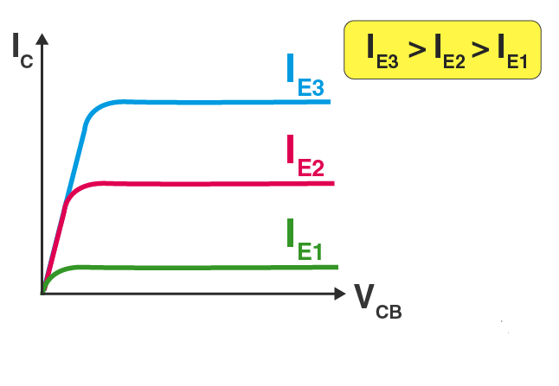

Output charecteristics
The variation of collector current(I_{C}) with Collector-Base voltage(V_{CB}), keeping the emitter current(I_{E}) constant

Slide 25
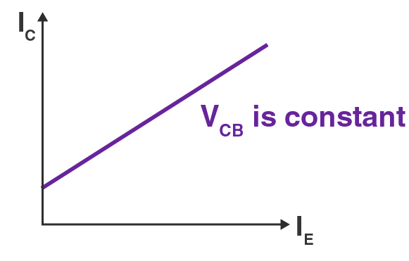
Current Transfer Characteristics
The variation of collector current(I_{C}) with the emitter current(I_{E}), keeping Collector Base voltage(V_{CB}) constant.
The resulting current gain has a value less than 1.

Slide 26
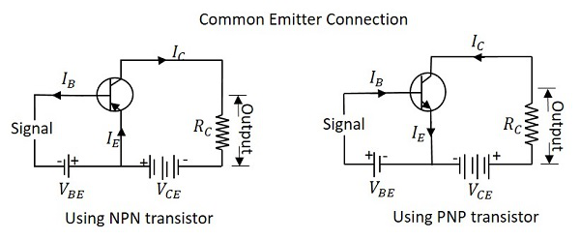
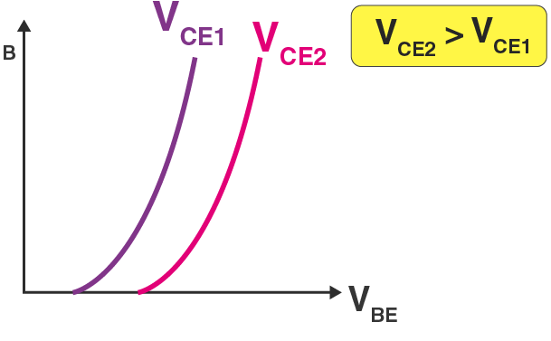
Common Emitter CE Configuration
The name itself implies that the Emitter terminal is taken as common terminal for both input and output of the transistor. The common emitter connection for both NPN and PNP transistors is as shown in the following figure.
Input Characteristics

Slide 27
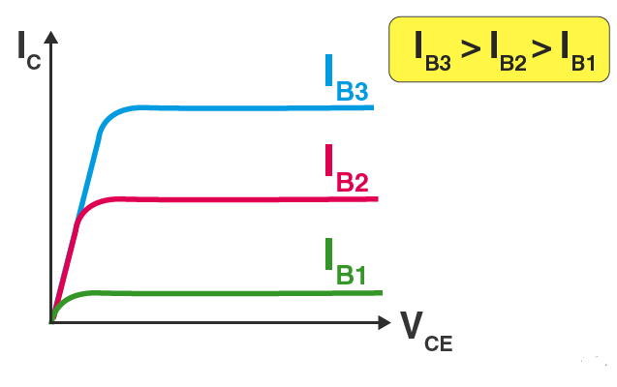
Output characteristics-CE
The variation of collector current(I_{C}) with Collector-Emitter voltage(V_{CE}), keeping the base current(I_{B}) constant.

Slide 28
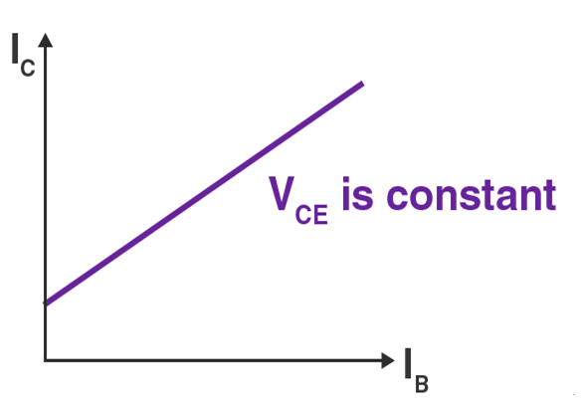
Current transfer charecteristics
The variation of collector current(I_{C}) with the base current(I_{B}), keeping Collector-Emitter voltage(V_{CE}) constant.
The resulting current gain has a value greater than 1.

Slide 29
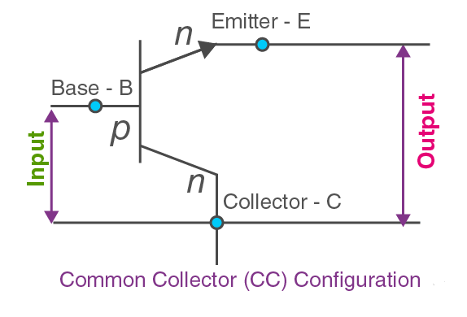
Common Collector configuration

Slide 30
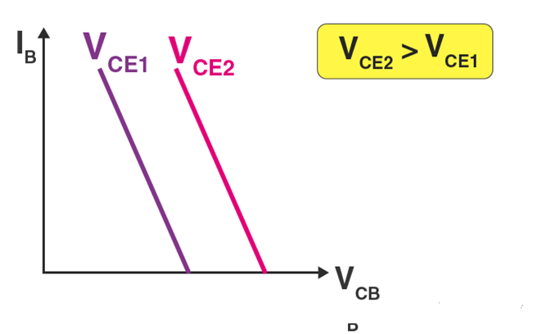
CC configuration charecteristics
Input Characteristics
The variation of emitter current(I_{B}) with Collector-Base voltage(V_{CB}), keeping Collector emitter voltage(V_{CE}) constant.

Slide 31
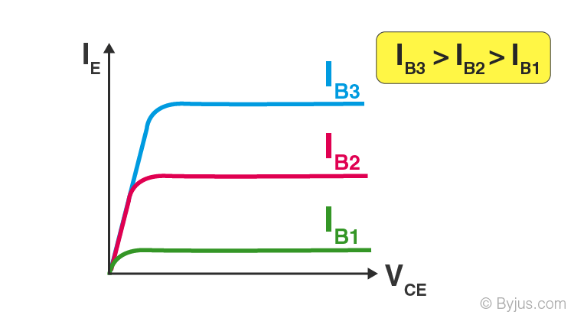
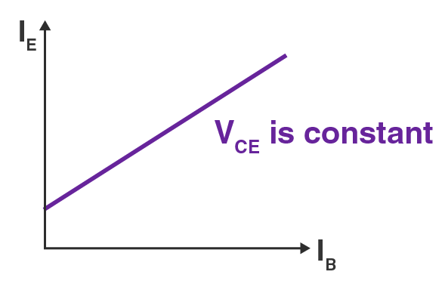
Output Characteristics
The variation of emitter current(I_{E}) with Collector-Emitter voltage(V_{CE}), keeping the base current(I_{B}) constant.
Current Transfer Characteristics

Slide 32
Comparison between CB,CE,CC
Characteristics | CB | CE | CC
Input Impedance | Low | Medium | High
Output Impedance | Very High | High | Low
Phase Shift | 0º | 180º | 0º
Voltage Gain | High | Medium | Low
Current Gain | Low | Medium | High
Power Gain | Low | Very High | Medium

Slide 33
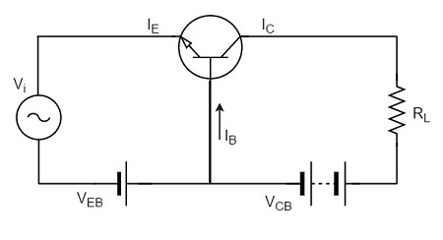
Transistor as an Amplifier
A transistor acts as an amplifier by raising the strength of a weak signal.
The low resistance in input circuit, lets any small change in input signal to result in an appreciable change in the output.

Slide 34
Continue..
Example
Let there be a change of 0.1v in the input voltage being applied, which further produces a change of 1mA in the emitter current. This emitter current will obviously produce a change in collector current, which would also be 1mA.
A load resistance of 5kΩ placed in the collector would produce a voltage of
5 kΩ × 1 mA = 5V
Hence it is observed that a change of 0.1v in the input gives a change of 5v in the output, which means the voltage level of the signal is amplified.

Slide 35
Thank you

